Slide 1



ITI Training 1-Month
Advanced Driver Assistance System

Slide 2



Contents
1
Introduction
2
ADAS Applications
3
Security ECU
4
Control ECU
5
Simulation

Slide 3
INTRODUCTION
Almost all vehicle accidents are caused by human error, which can be avoided with Advanced Driver Assistance Systems (ADAS). The role of ADAS is to prevent deaths and injuries by reducing the number of car accidents and the serious impact of those that cannot be avoided.

Slide 4

Adaptive Light Control
Adaptive light control adapts the vehicle’s headlights to external lighting conditions. It changes the strength, direction, and rotation of the headlights depending on the vehicle’s environment and darkness.
Automatic Parking
Automatic parking helps inform drivers of unseen areas so they know when to turn the steering wheel and stop. Vehicles equipped with rearview cameras have a better view of their surroundings than traditional side mirrors. Some systems can even complete parking automatically without the driver’s help by combining the input of multiple sensors..
Applications
Night Vision
Night vision systems enable drivers to see things that would otherwise be difficult or impossible to see at night.

Slide 5
Driver Monitoring System
The driver monitoring system is another way of measuring the driver’s attention. The camera sensors can analyze whether the driver’s eyes are on the road or drifting. Driver monitoring systems can alert drivers with noises, vibrations in the steering wheel, or flashing lights.
Brake Assistant System (BAS)
It is a safety feature in modern vehicles designed to enhance braking performance during emergency situations. This system works by detecting when a driver is making a sudden or forceful application of the brakes, which typically indicates an emergency stop.
Applications
Speed Limiter System (SL)
A speed limiter system is a feature in vehicles designed to prevent the vehicle from exceeding a set speed limit. It helps drivers maintain a safe and legal speed, reducing the risk of accidents and fines associated with speeding.

Slide 6
Security ECU
The ECU is connected to a keypad to enter a password for each start.
Passwords are saved in EEPROM and are equal to ‘1’ , ‘2’ , ‘3’ , ‘4’. For each start, the system compares the input entered by the keypad after pressing the ‘ = ’ button.
If the password does not match, the red lamp will turn on for 700 ms and then turn off.
If the password matches, the green lamp will turn on for 700 ms and then turn off. The servo motor will move to an angle of +90 degrees and then return to 0 degrees after 1 second.
The ECU sends the ‘A’ character through UART if the password is correct.
ITI Training 1-Month

Slide 7
Control ECU
All subsystems are off until UART receives the ‘A’ character from the security ECU. The ECU is connected with 3 push buttons: the 1st and 3rd buttons for SL and CCS, and the 2nd button for exchanging the gearbox (D, N, P, R).
Brake Assistant System (BAS): The system is turned on when the gearbox is in D and returns to off otherwise. The system uses the distance measured by the ultrasonic sensor To Control The Bas Led .
- If the distance is > 10 cm: BAS LED is off.
- If the distance is > 5 cm, BAS LED is toggled every 100 ms.
- Otherwise, the BAS LED is turned on.
ITI Training 1-Month

Slide 8
Control ECU Cont.
Speed Limiter System (SL): The system is turned on using the SL push button when the gearbox is in D and returns to off if the gearbox isn’t in D or if the SL push button is used. The SL LED will turn on if SL is on and turn off otherwise.
Cross Control System (CCS): The system is turned on using the CCS push button when the gearbox is in D and returns to off if the gearbox isn’t in D, or if the CCS push button or gas potentiometer is exchanged. The CCS LED will turn on if the CCS is on and turn off otherwise.
Kilometer Counter: Print the kilometer value on the LCD. This value will increment at a high rate if the gas potentiometer is high and vice versa.
ITI Training 1-Month

Slide 9
Control ECU Cont.
Drive Monitoring: The system is turned off by default because the gearbox is in N by default. The system is turned on when the gearbox is in D and returns to off otherwise. The system is monitoring the driver. If the timer counts 5 seconds without any change in the system, the buzzer will be toggled every 100 ms
ITI Training 1-Month

Slide 10
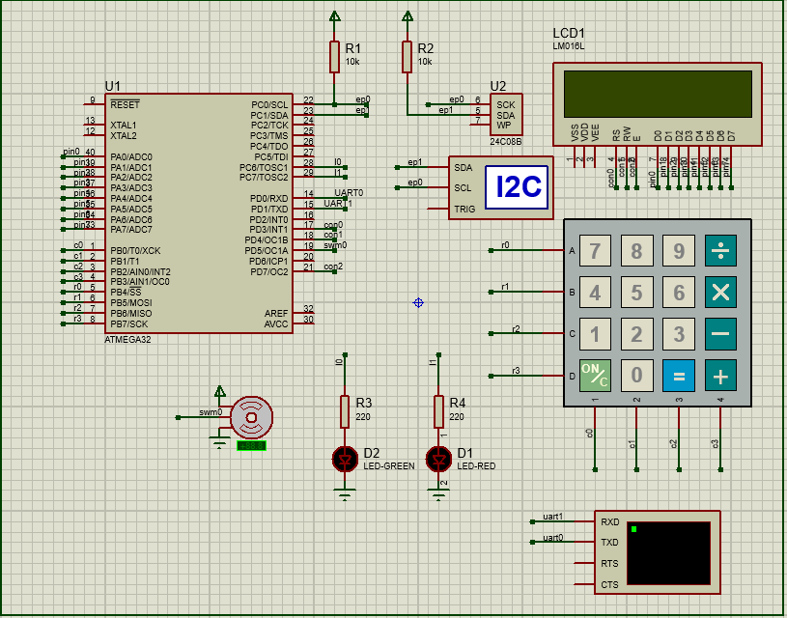
Security ECU

Slide 11
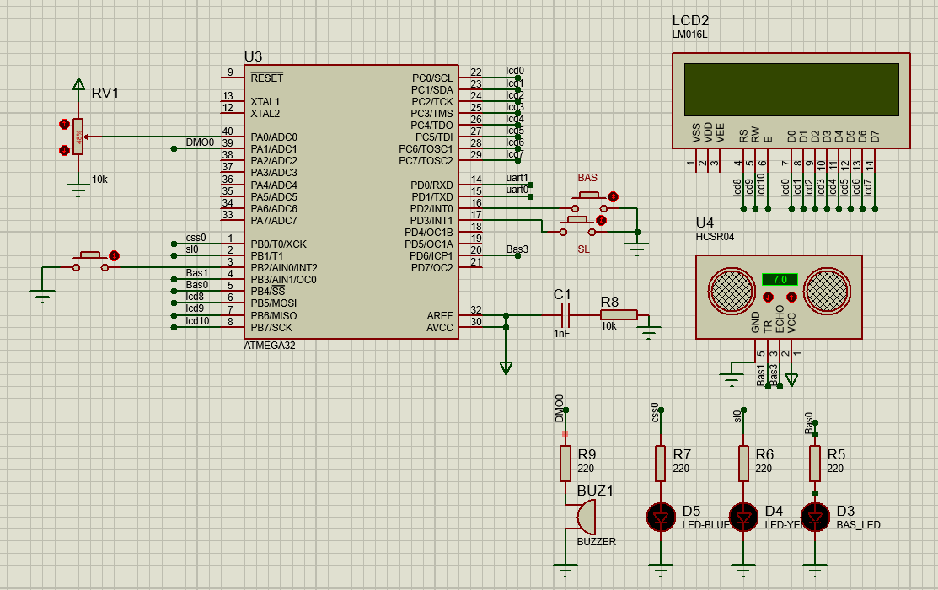
Control ECU

Slide 12
OUR TEAM
Abdelrahman x (Ahmed + Hassan + Ali + Mohamed)
THANK YOU
for your time and attention
ITI Training 1-Month

